Slide 1
Object-Oriented Programming
Object-oriented programming (OOP) is a programming paradigm based on the concept of "objects", which can contain data and code. The data is in the form of fields (often known as attributes or properties), and the code is in the form of procedures (often known as methods).
Source: https://en.wikipedia.org/wiki/Object-oriented_programming

Slide 2
Reading
Read section II and III of the paper “Has the Object-Oriented Paradigm Kept Its Promise?”
lutzhamel.github.io/CSC493/docs/OOPP.pdf
If you are interested, take a peek at Bertrand Meyer’s classic “Object-Oriented Software Construction”. Of particular interest is Section D
lutzhamel.github.io/CSC493/docs/OOSC.pdf

Slide 3
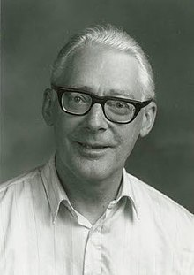
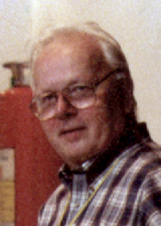

Origins of OOP
Ole-Johan Dahl, Professor Computer Science, 1931-2002
Kristen Nygaard, Computer Scientist, 1926-2002
Simula is a language designed to solve problems in simulations
Introduced objects, classes, inheritance and subclasses, and featured garbage collection.
Inspired by the observation that simulations become more robust when object state and behavior are bundled
Considered to be the first truly object-oriented programming language.
Developed in the 1960’s

Slide 4


Origins of OOP
Dr Alan Kay, computer scientist,
1940-
Smalltalk
Influenced by the ideas in Simula and Lisp
Pure OO, “Everything is an object” – even primitive entities like integers
Highly influential because of the pure OO aspect
Other languages make tradeoffs due to performance issues
Developed in the 1970’s
Open-source modern implementation
https://squeak.org/

Slide 5
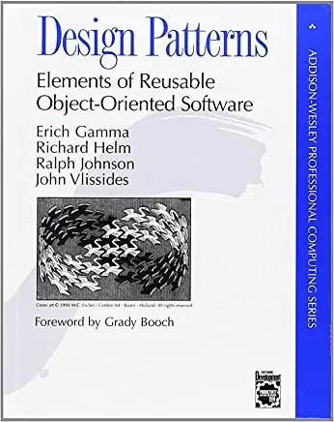
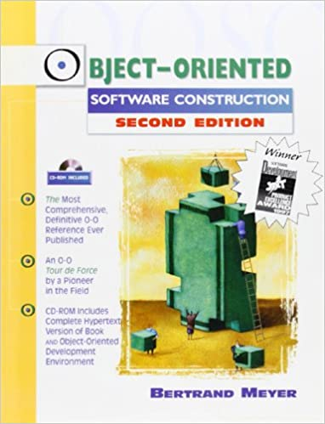
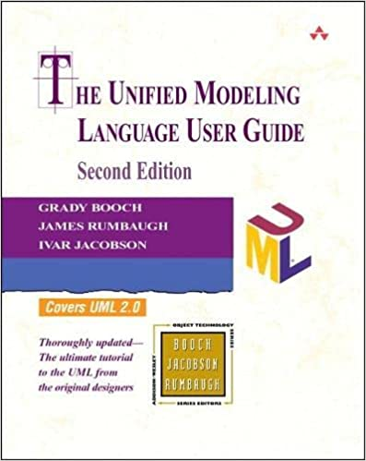
Origins of OOP
Some classics from the “classic” OOP period
Bertrand Meyer, designer of Eiffel, design by contract
Grady Booch, inventor of UML
“Gang of Four”, design patterns were hugely influential on OO architectures and OOP

Slide 6
Object-Oriented Programming
Object-oriented programming (OOP) is a programming paradigm that uses objects and their interactions to design applications and frameworks (e.g. GUI, webservers).
It is based on the concept of "objects", which can contain data and code that manipulates that data and an object identity.
“Classic” OOP languages, such as Java and C++ provide features such as encapsulation, inheritance, and polymorphism to help organize and reuse code.
Encapsulation refers to the practice of keeping an object's internal state and behavior hidden from the outside world, while exposing a public interface.
Inheritance allows one class to inherit properties and methods from a parent class.
Polymorphism allows objects of different classes to be treated as objects of a common superclass.

Slide 7
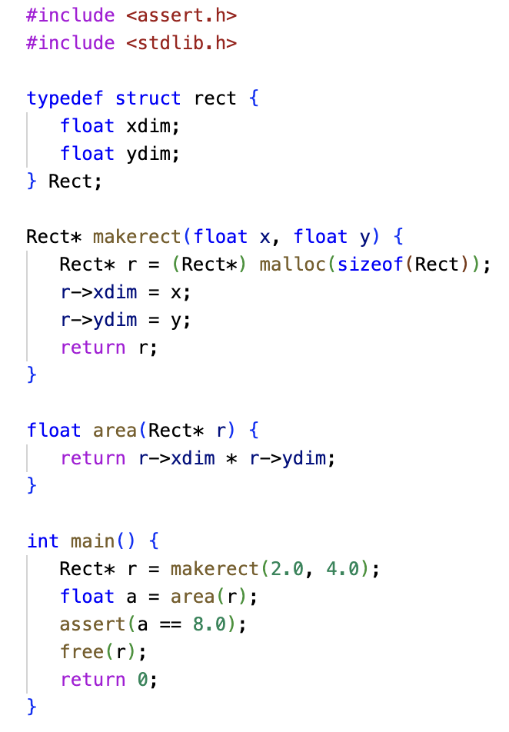
Object Identity
In non-OOP setting objects only have external identity (reference)
This changes in the OOP setting where member functions can refer to the object they belong to via an “internal” identity
ln007/rect.c

Slide 8
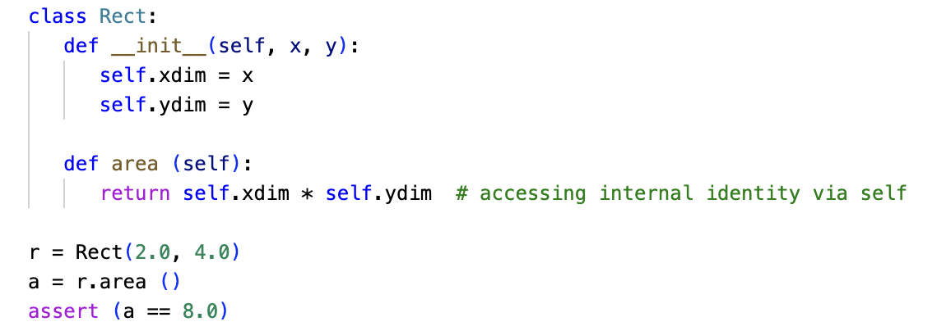
Object Identity – OOP
In Python ”self” refers to the internal object identity
ln007/rect.py

Slide 9
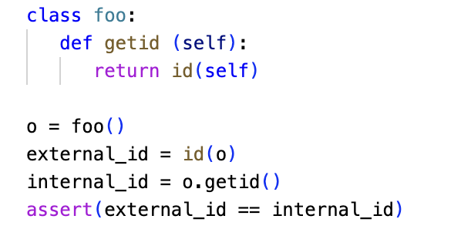
Object Identity – OOP
External object identity and internal object identity are the same!
ln007/id.py

Slide 10
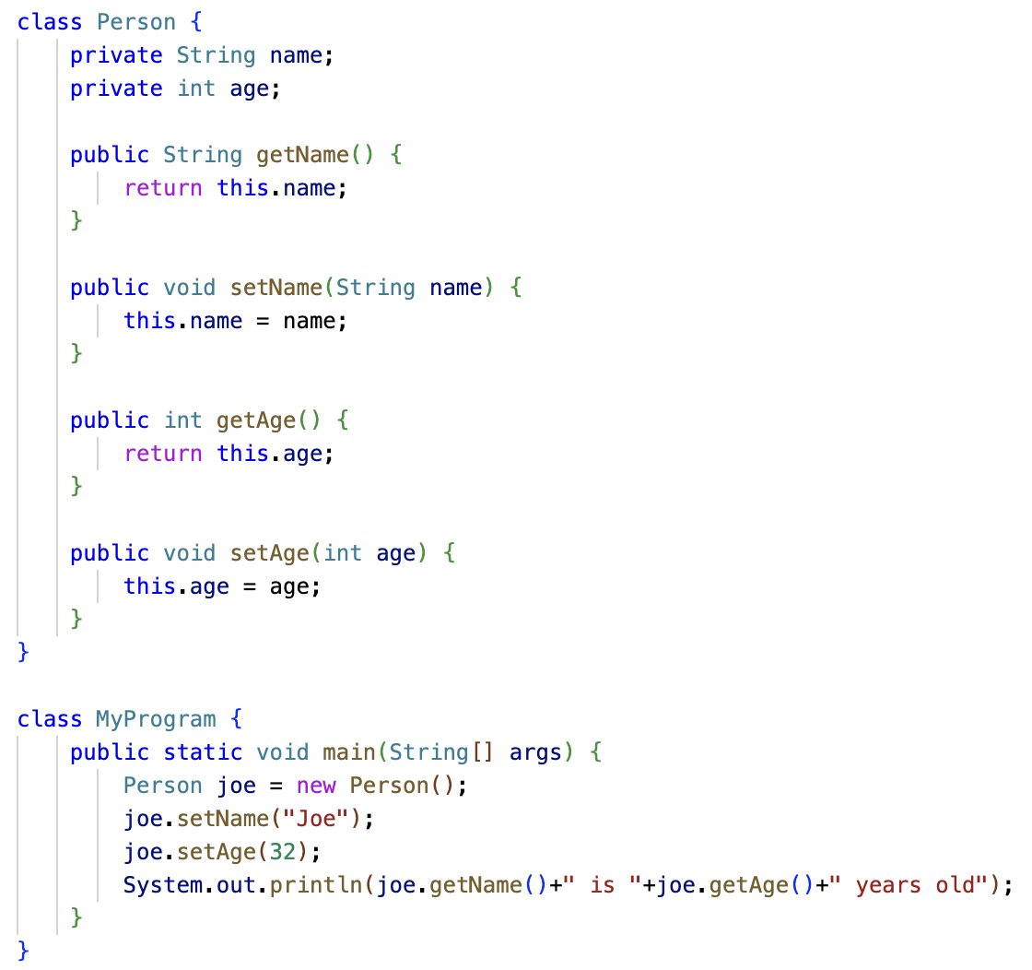
Encapsulation
Data members are “private”
Setter/getter functions
Pros: precise modeling of the notion of “object”
Cons:
Cluttering of public interface with trivial setter/getter functions
Private members are not available to derived classes, which is strange because derived objects own this attribute
To solve this yet another access attribute: protected
ln007/person.java

Slide 11
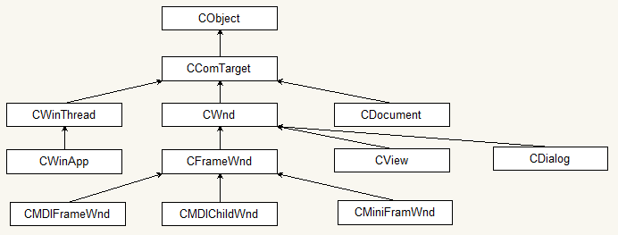
Inheritance
Pros: precise modeling of the perceived inheritance relation (is-a) of objects
Cons:
Static structure: difficult to evolve with changing software requirements
Aggregation: classes at the leaves inherit ALL of the data members and functions of the preceding classes
Partial hierarchy of the Microsoft Foundation Classes (MFC)
Image source: https://commons.wikimedia.org/wiki/File:MFC_hierarchy.png

Slide 12
Multiple-Inheritance – The Diamond Problem
Briefly:
An ambiguity that arises when two classes B and C inherit from A, and class D inherits from both B and C.
If there is a method in A that B and C have overridden, and D does not override it, then which version of the method does D inherit: that of B, or that of C?
That is: D.foo() – which foo() should be called?
This gets really problematic in deep inheritance structures.
foo()
foo()
foo()

Slide 13
The Diamond Problem
Different languages deal with the diamond problem in different ways
C++ uses a fully qualified syntax
Python uses a class hierarchy linearization algorithm (C3 linearization or MRO) to resolve ambiguities
Java does not support multiple inheritance.
MRO: Method Resolution Order

Slide 14
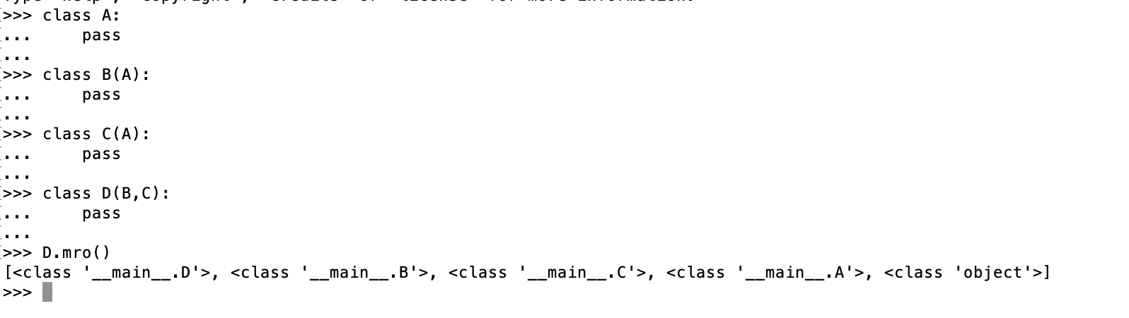
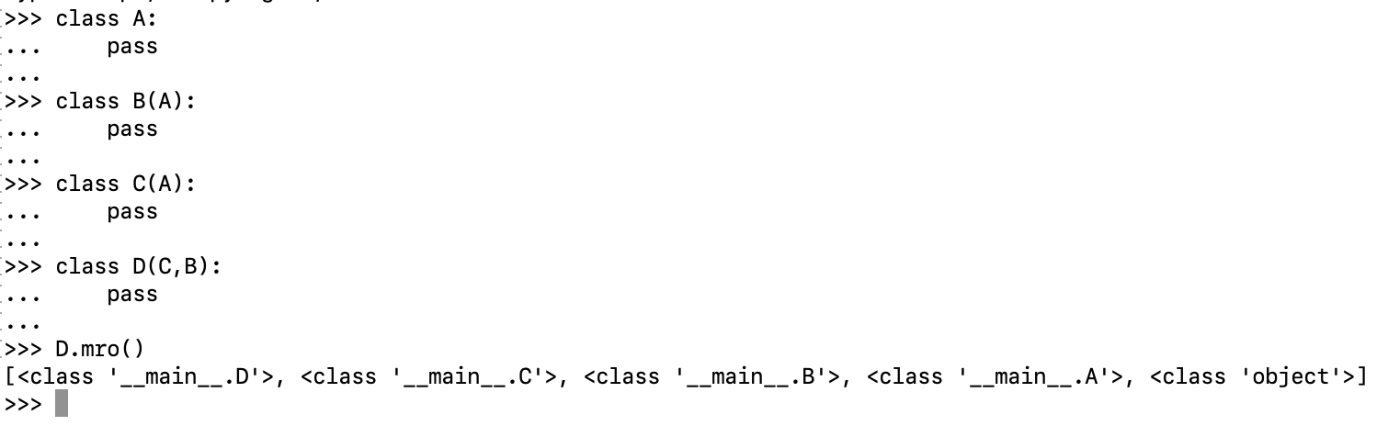
The Diamond Problem
In Python, the method that is called depends on the order of your inheritance specification !?!

Slide 15
Subtype Polymorphism
Subtype polymorphism is a feature in object-oriented programming (OOP) in which a subclass or derived class can be used in place of its superclass or base class.
This means that an object of a subclass can be treated as an object of its superclass, and it will respond to the same methods and properties as an object of the superclass.
This allows for more flexibility and reusability in code, as objects can be treated generically and interchangeably based on their common base class(es), rather than having to be treated as specific instances of a class.

Slide 16
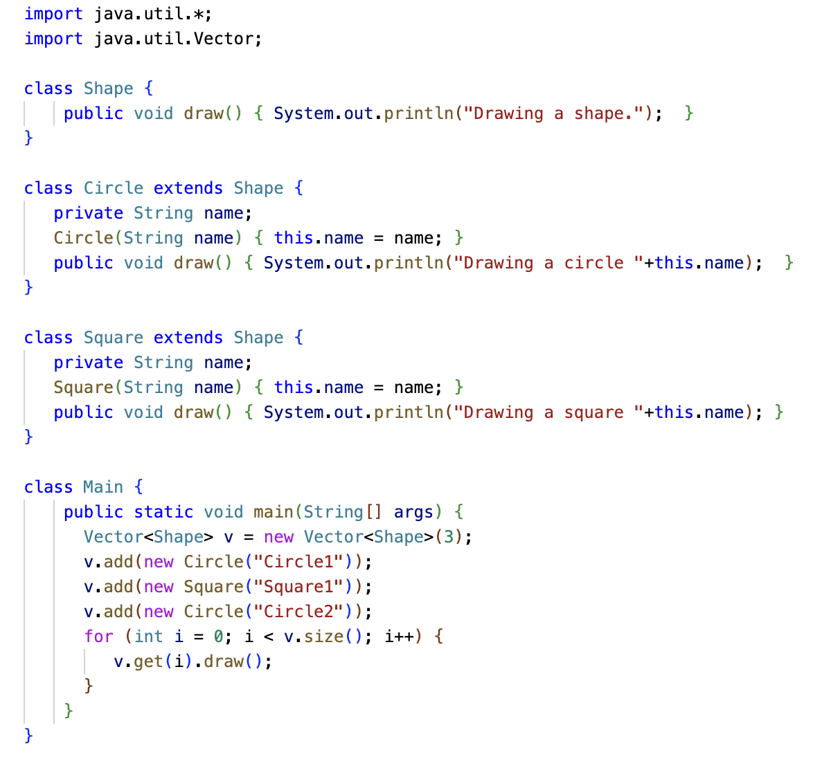
Subtype Polymorphism
Generic Shape Container
Adding specific Shapes
ln007/subpoly.java
Dynamic dispatching to call the correct draw() method

Slide 17
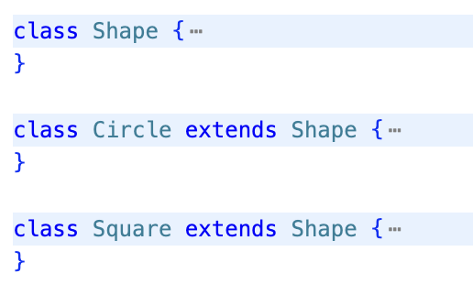
OOP – Foundations
Objects of type Shape
Shape
Circle
Square
Objects of type Circle
Objects of type Square
A class defines a type
A type is a set of values
The values of a type defined by a class are the objects that can be instantiated from that class, e.g.
new Circle()

Slide 18
OOP – Foundations
Shape
Circle
Square
From our class hierarchy we have
Circle < Shape
Square < Shape
From our interpretation of subtypes as subsets we have
Every Circle is a Shape, and every Square is a Shape; green arrows, widening conversion
But not every Shape is either a Circle or a Square; red arrows, narrowing conversion

Slide 19
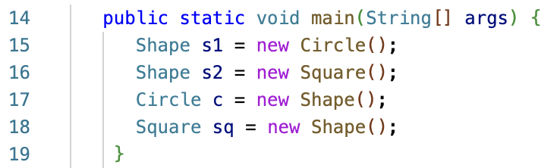
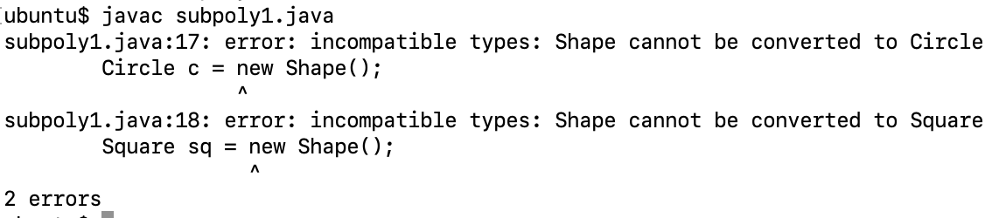
OOP – Foundations
Shape
Circle
Square

Slide 20
OOP – Subtype Polymorphism
Now that we have looked at the set theoretic foundations of OOP let’s take another look at subtype polymorphism
In particular, the idea of dynamic dispatch which makes this so extremely useful

Slide 21
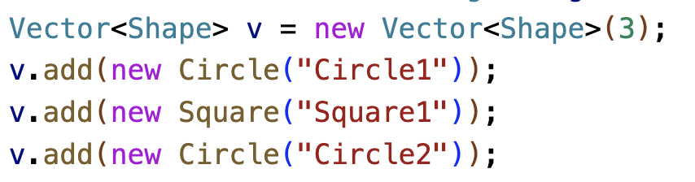
OOP – Subtype Polymorphism
We will use the example from before: create a list of circles and squares and then have each object on the list draw itself.
Caveat: in statically types languages lists/vectors can only have homogeneously type elements
Solution: Use a list/vector where the elements are elements of the base type of our Shape hierarchy BUT we insert our actual Circle and Square objects.
We say that v is a subtype polymorphic list/vector because the objects on the list/vector consist of different subtypes of Shape.

Slide 22
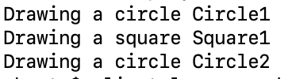
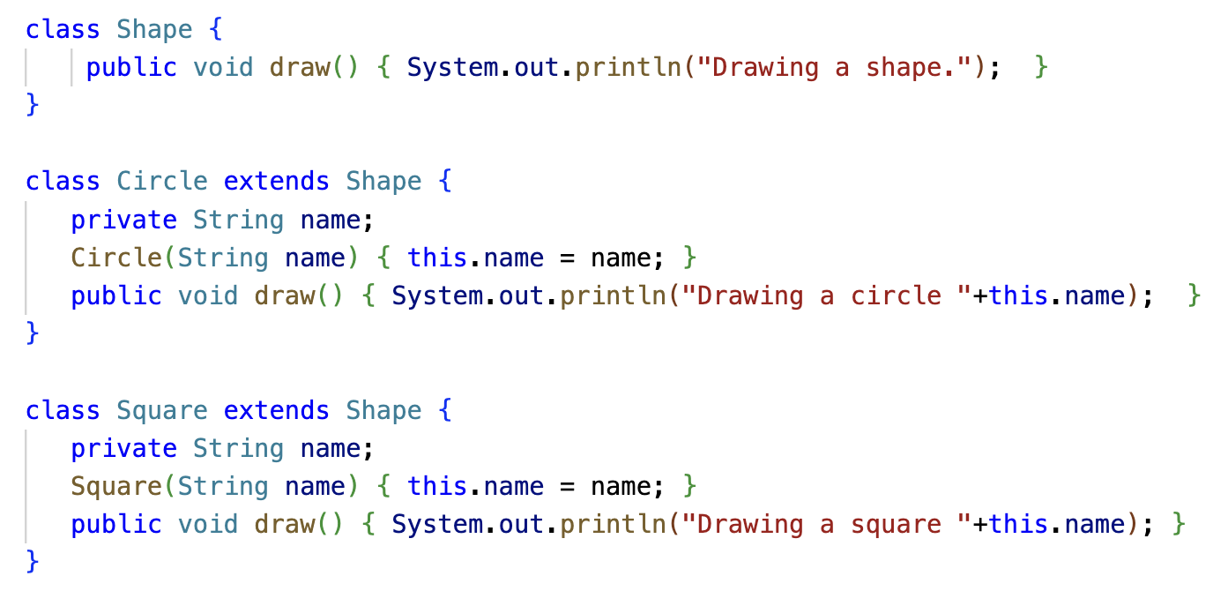
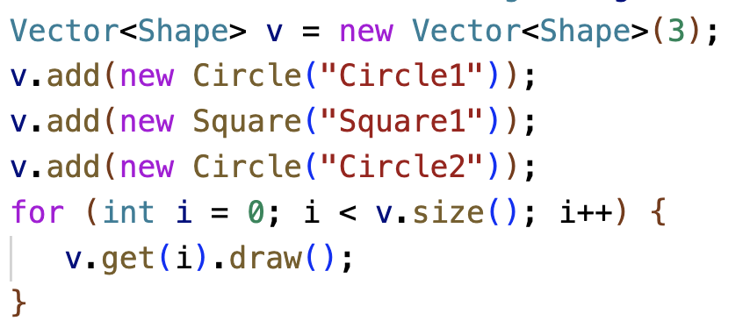
OOP – Subtype Polymorphism
Finally, dynamic dispatch makes this all work.
In the code below we call the draw function on the base class Shape
But what is actually called are the draw functions of the subtypes – dynamic dispatch

Slide 23
OOP – Subtype Polymorphism
Shape
draw()
Shape
draw()
Shape
draw()
Vector<Shape> v =
Circle
“Circle1”
draw()
Square
“Square1”
draw()
Circle
“Circle2”
draw()
Dynamic dispatch realizes when calling the draw function of the base class that a more specific draw function exists and calls that instead of the draw function of the base class.

Slide 24
Dynamically Typed Languages
In dynamically typed languages lists are untyped containers, i.e.
[1,”two”,3.0] is legal
That means, lists in dynamically typed languages are by default polymorphic!
Here, subtype polymorphism with dynamic dispatch is replaced by duck typing,
"If it walks like a duck and it quacks like a duck, then it must be a duck” – the duck test.
Source: https://en.wikipedia.org/wiki/Duck_typing

